Slide 1

FRAGMENT BASED DRUG DESIGN OF ANTHELMINTIC USING GENETIC ALGORITHM
Supervisor
Dr.Venkatasubramanian Ulanganathan
Nikil Krishna
126010091
Notes:
greetings
Refresh previous procedure

Slide 2
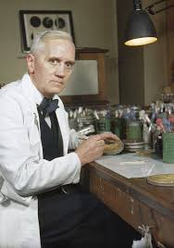
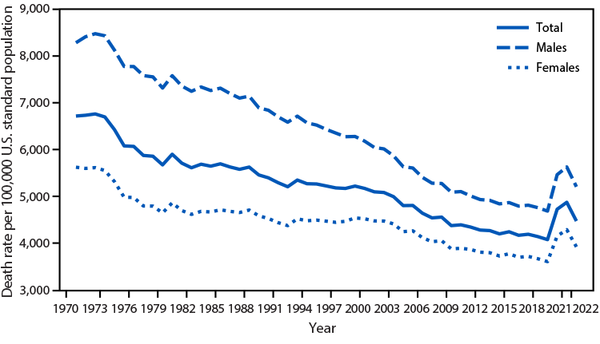
Introduction
The development of small molecules revolutionized treatments, beginning with iconic drugs like penicillin and aspirin.
Computational drug design enables rapid, cost-effective, and innovative solutions to global health challenges.

Slide 3
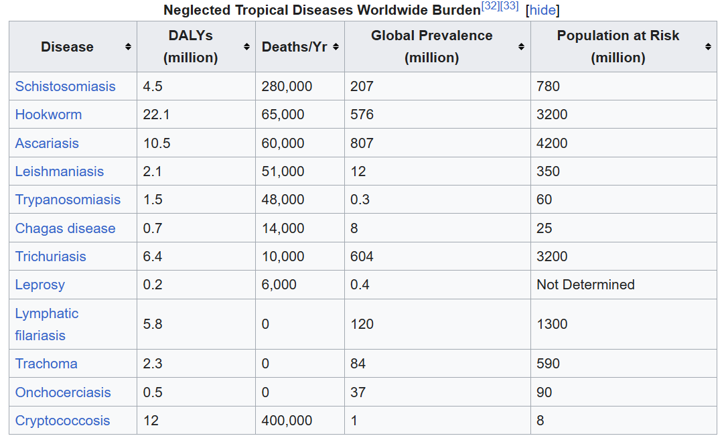
PARASITIC DISEASES
Global Health Impact
Economic
Consequences
Mortality, Morbidity
Drug Resistance

Slide 4
Aim
The aim of this study is to use computational methods to accelerate drug treatment efforts to treat a parasitic disease affecting humans posing high burden.
To evaluate Combinatorial chemistry as a method to produce drugs with better therapeutic properties than current treatment options
Rationale
Current anthelmintic drugs face challenges such as drug resistance and limited efficacy. The study attempts to address this and provide better need to develop effective treatments for parasitic diseases

Slide 5
Literature Review
Author,Year | Title | Inference
De Souza Neto et al. 2024 | Fragment library screening by X-ray crystallography and binding site analysis on thioredoxin glutathione reductase of Schistosoma mansoni | Use of FBDD Binding pocket identification Binding pocket analysis of TGR
Zdesenko,Grace 2020 | Drug metabolism and pharmacokinetics of praziquantel: A review of variable drug exposure during schistosomiasis treatment in human hosts and experimental models | Mechanism of action of praziquantel Pharmacokinetics Limitations of using praziquantel treatment
Spiegel, Durrant 2020 | An open-source genetic algorithm for de novo drug design and lead optimization | Use of genetic algorithm for chemical space exploration Novel small molecule generation

Slide 6
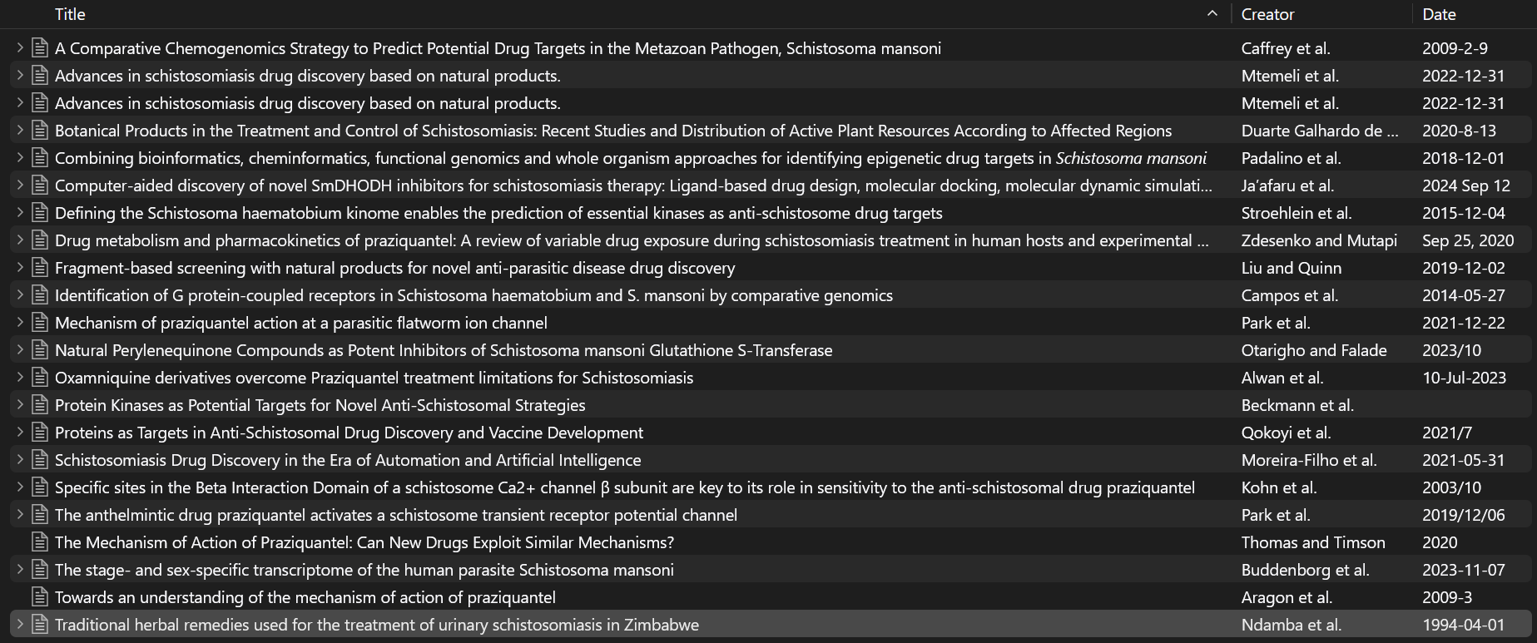

Slide 7
Objectives
To identify a parasitic disease that imposes a significant burden on global health.
To identify a protein target with therapeutic potential in the causative organism.
To conduct binding pocket analysis to determine its characteristics
To scaffold core fragments using Ligbuilder
To perform lead optimization using genetic algorithm (Autogrow4)
To perform basic ADMET analysis

Slide 8
WORKPLAN
Method Discovery
(Week 0)
Lead Optimisation
Using Genetic Algorithm
(Week 10)
Scaffolding
Using FBDD
(Week 6)
Protein Target
Identification
(Week 2)
Preliminary ADMET
(Week 14)
Target Discovery
(Week 1)
Notes:
Mention starting plan
Short procedure

Slide 9


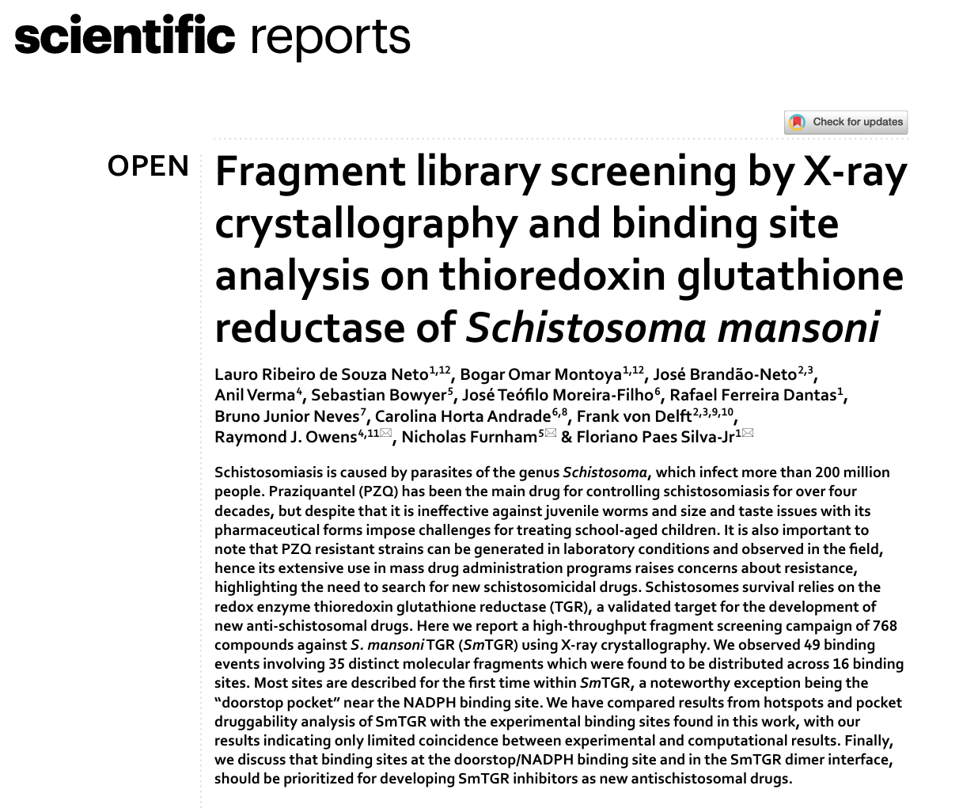
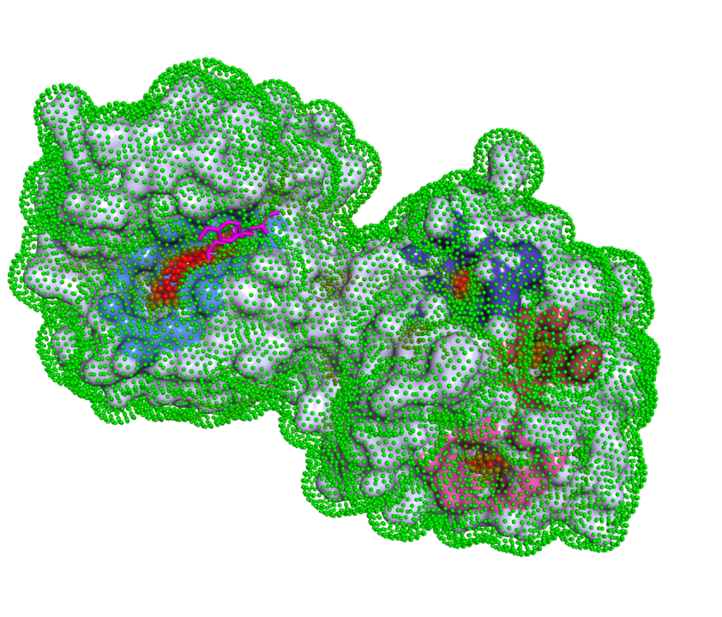
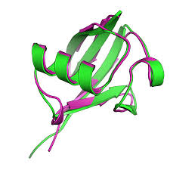
2) PROTEIN TARGET IDENTIFICATION
Binding pocket prediction of proteome
Structural proteome comparison
Literature Review
FOLDSEEK
Notes:
Three methods
Binding pocket pred
Structural superoposition
Literature

Slide 10
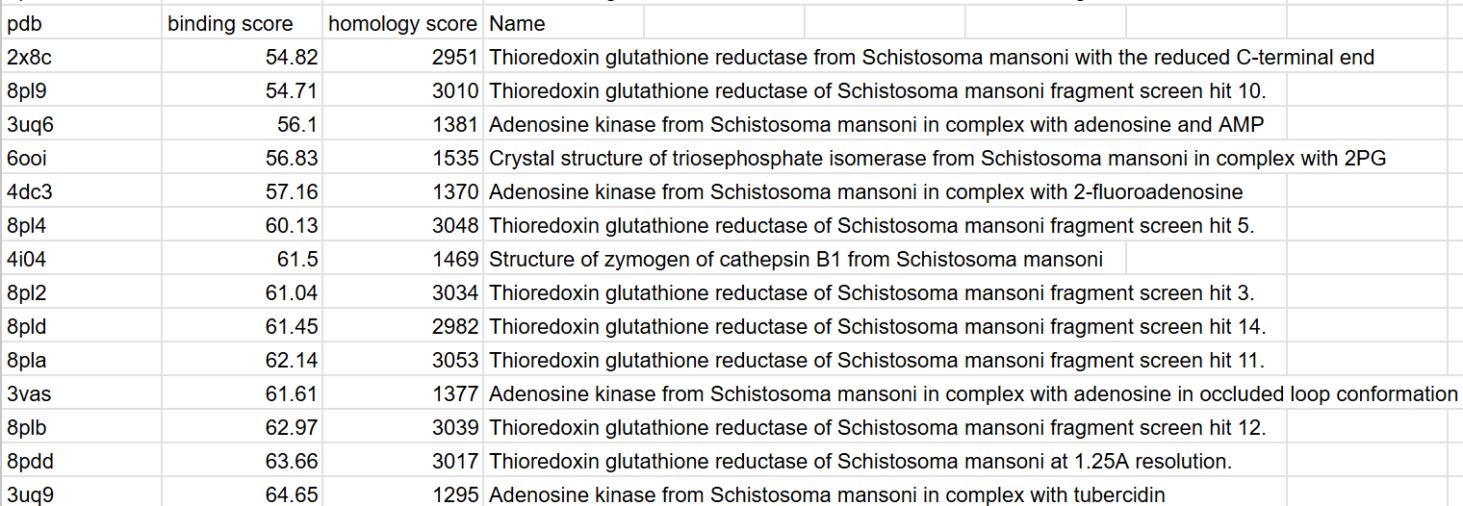
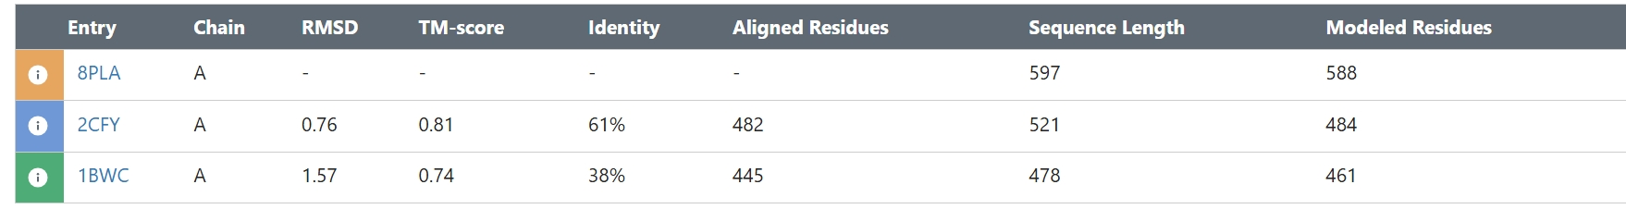
RESULTS
Notes:
-tell procedure done
- explain probability
- explain homology
- ascending order

Slide 11
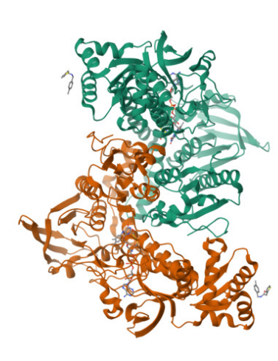
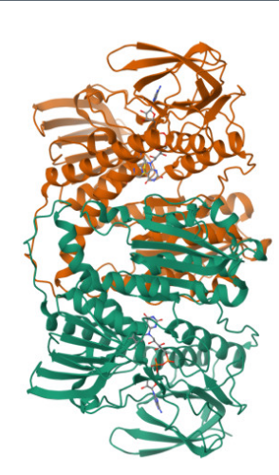
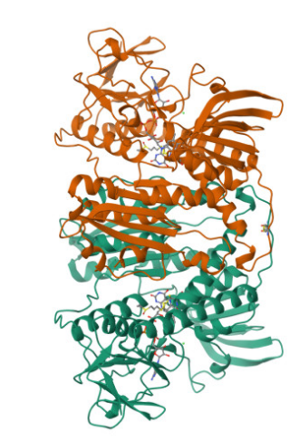
Schistosoma Mansoni
+ =
Thioredoxin Reductase
Glutathione Reductase
Thioredoxin Glutathione Reductase
Notes:
- tgr function
- tr,gr function
- difference

Slide 12
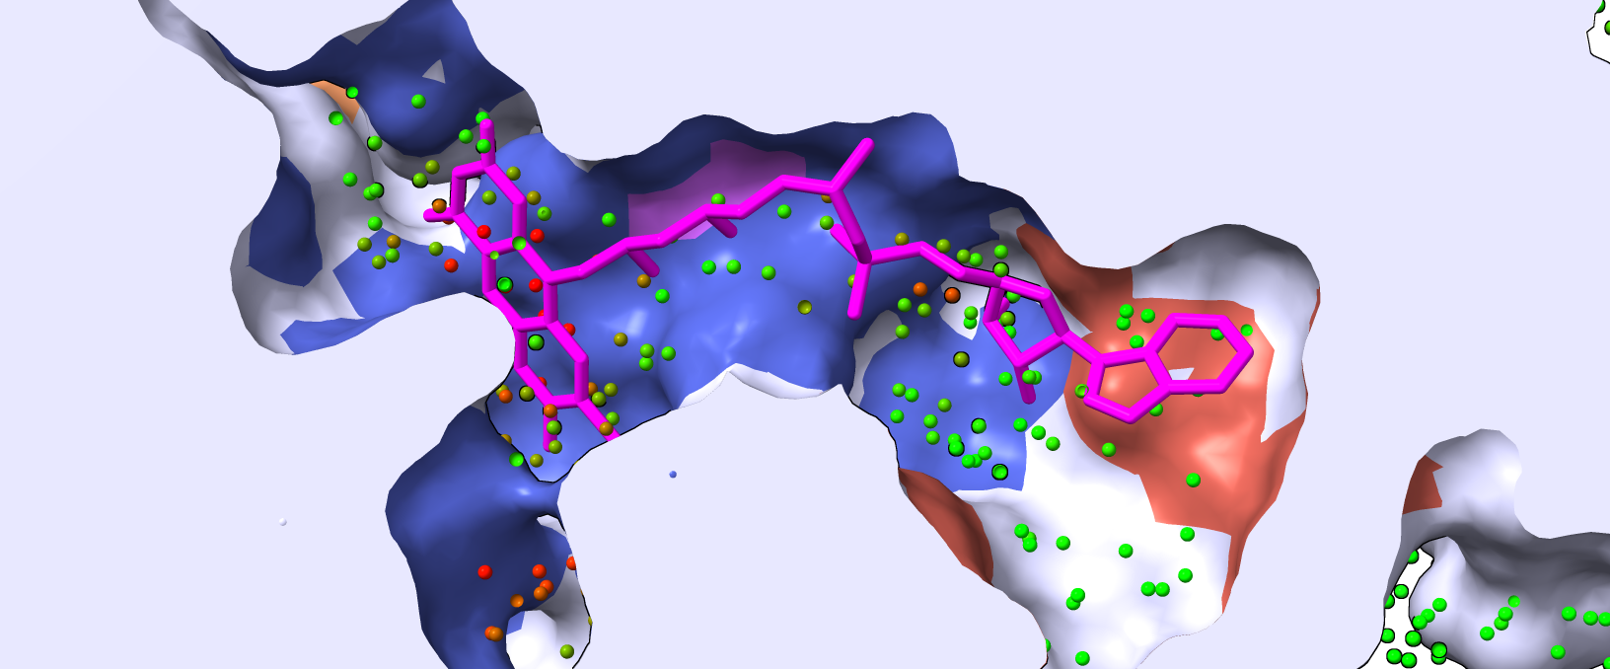
3) BINDING POCKET ANALYSIS
P2rank Result
Pocket #1 Pocket #2
Notes:
ML results
Explain bottom two detail
Point the tyrosine

Slide 13
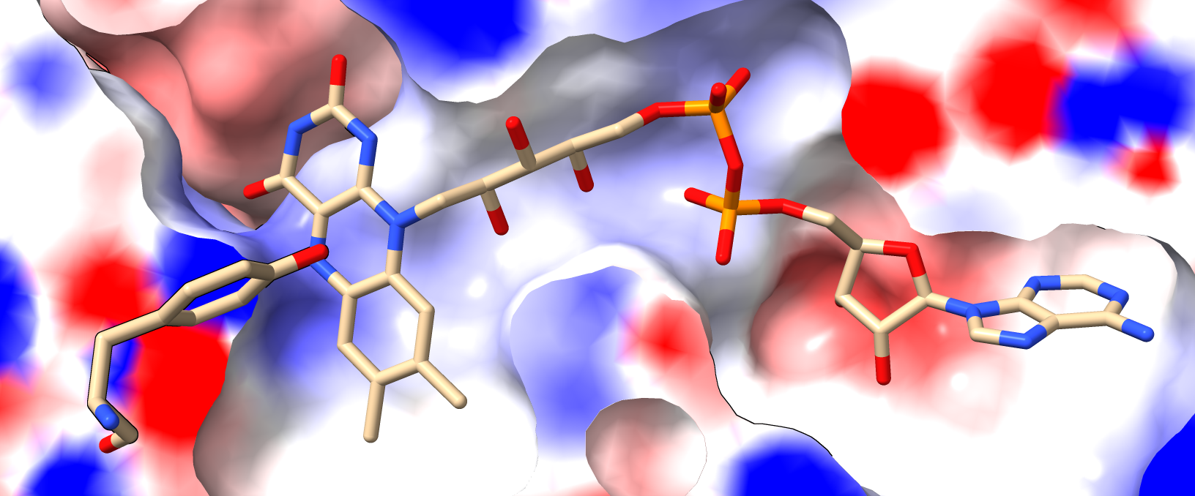
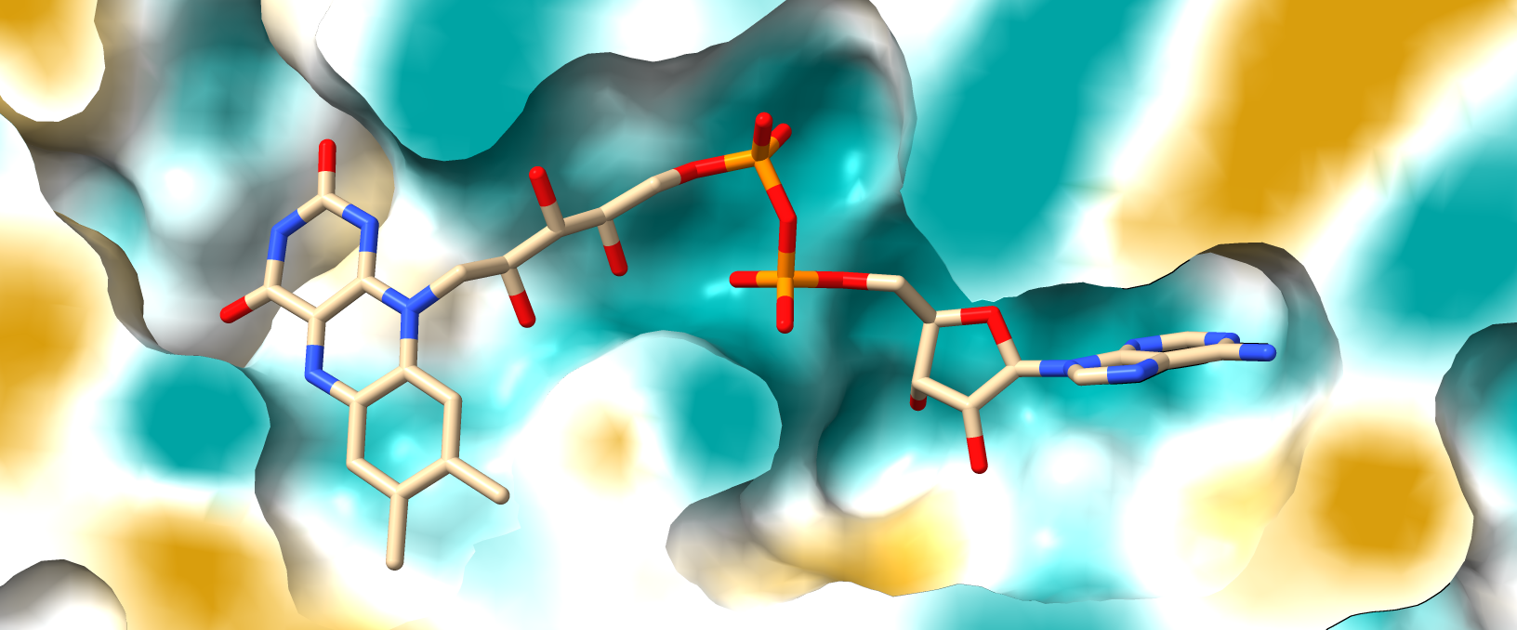
BINDING POCKET VISUALISATION
ELECTROSTATIC MAP LIPOPHILICITY MAP
Positive Negative Hydrophillic

Slide 14
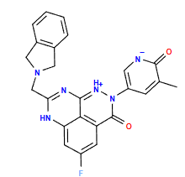
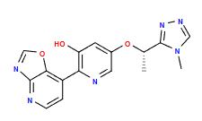
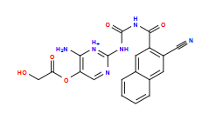
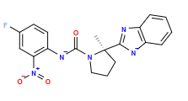
4) SCAFFOLD CORE FRAGMENTS USING LIGBUILDER
RESULTS
-12.9 kcal/mol
-9.7 kcal/mol
-10.4 kcal/mol
-11.0 kcal/mol
QuickVina2Docking (8)
Notes:
Result of ligbuilder+autogrow4
Mention binding affinities and probable ki
Mention dock software

Slide 15
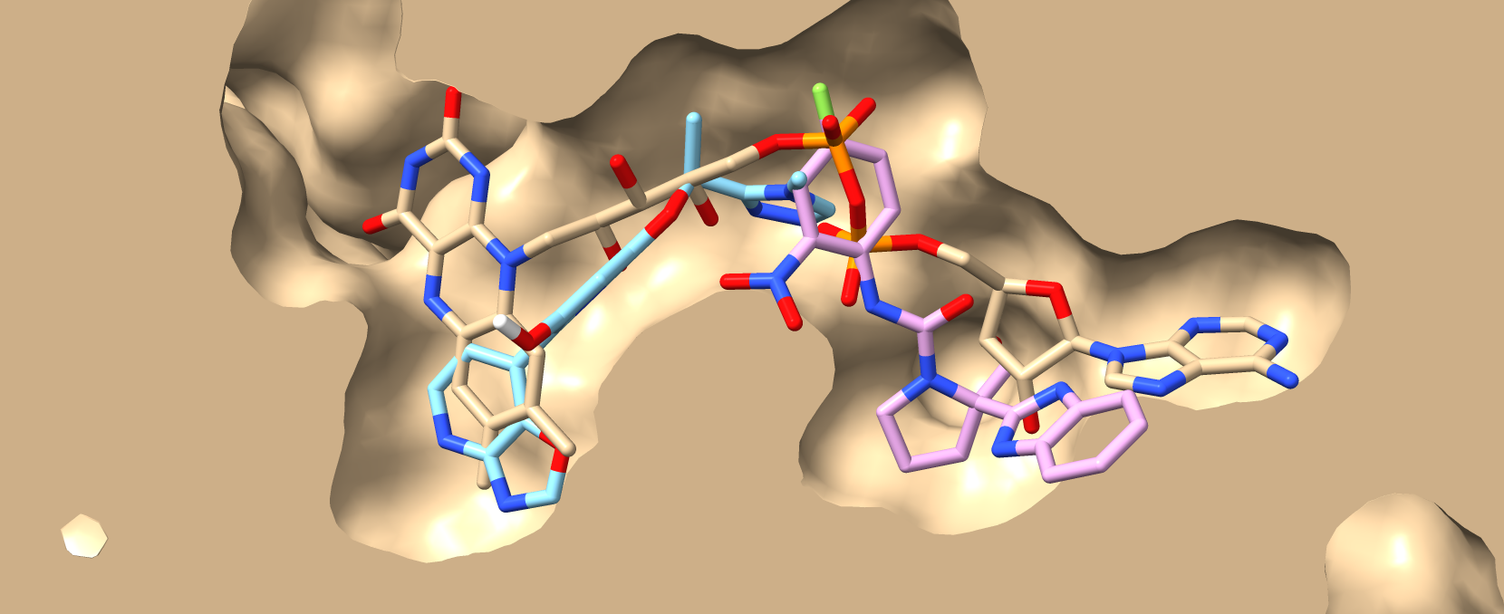
-9.7 -10.4 FAD
Notes:
Mention similarities to fad
Provide general idea of drug strucuture

Slide 16
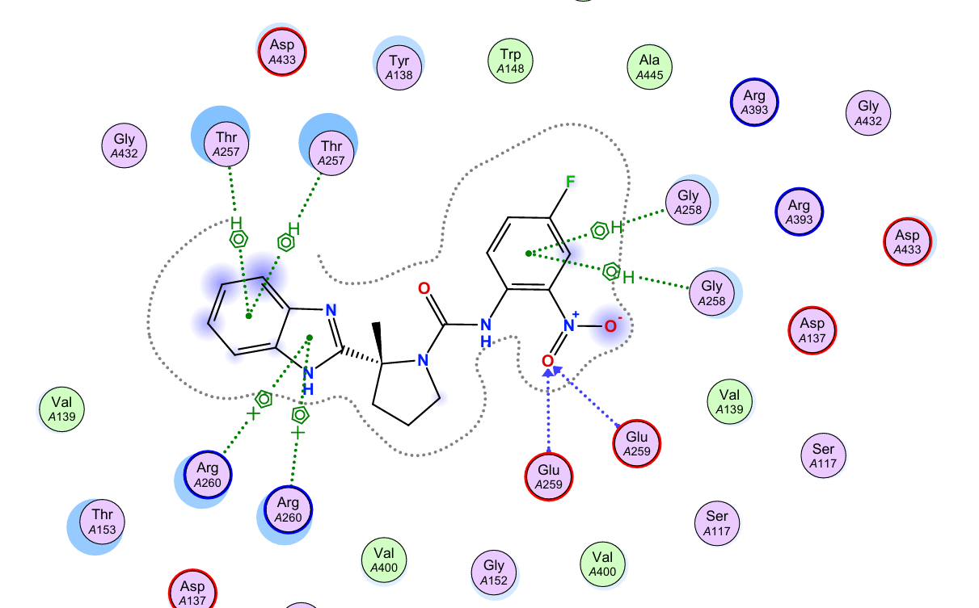
2D INTERACTION DIAGRAM
Notes:
Explain 2d diag
Provide imp info of SAR

Slide 17
Summary
To identify a parasitic disease that imposes a significant burden on global health. (Schistosomaniasis)
To identify a protein target with therapeutic potential in the causative organism. (Thioredoxin Glutathione Reductase)
To conduct binding pocket analysis to determine its characteristics
(FAD pocket)
To scaffold core fragments using Ligbuilder
To perform lead optimization using genetic algorithm (Autogrow4)
To perform basic ADMET analysis

Slide 18
References
Krivák, R., Hoksza, D. P2Rank: machine learning based tool for rapid and accurate prediction of ligand binding sites from protein structure. J Cheminform 10, 39 (2018). https://doi.org/10.1186/s13321-018-0285-8
van Kempen, M., Kim, S., Tumescheit, C., Mirdita, M., Lee, J., Gilchrist, C.L.M., Söding, J., & Steinegger, M. (2023). Fast and accurate protein structure search with Foldseek. Nature Biotechnology. https://doi.org/10.1038/s41587-023-01773-0
Sebastian Bittrich, Joan Segura, Jose M Duarte, Stephen K Burley, Yana Rose, RCSB protein Data Bank: exploring protein 3D similarities via comprehensive structural alignments, Bioinformatics, Volume 40, Issue 6, June 2024, btae370, https://doi.org/10.1093/bioinformatics/btae370
Yuan, Y., Pei, J., & Lai, L. (2020). LigBuilder V3: A Multi-Target de novo Drug Design Approach. Frontiers in Chemistry, 8, 142. doi:10.3389/fchem.2020.00142
de Souza Neto, L.R., Montoya, B.O., Brandão-Neto, J. et al. Fragment library screening by X-ray crystallography and binding site analysis on thioredoxin glutathione reductase of Schistosoma mansoni. Sci Rep 14, 1582 (2024). https://doi.org/10.1038/s41598-024-52018-2
Meng, E.C., Goddard, T.D., Pettersen, E.F., Couch, G.S., Pearson, Z.J., Morris, J.H., & Ferrin, T.E. (2023). UCSF ChimeraX: Tools for structure building and analysis. Protein Science, 32(11), e4792. doi:10.1002/pro.4792.

Slide 19
THANK YOU

